Slide 1
PREDICTIVE MODELING FOR DIABETES-RELATED READMISSIONS IN U.S HOSPITALS
IE 7300: STATISTICAL LEARNING FOR ENGINEERING
TEAM MEMBERS:
NIRESH SUBRAMANIAN
002745713
subramanian.ni@northeastern.edu
SACHIN DEWANGAN
002771508
dewangan.s@northeastern.edu
VISHNU GIRISH
002781416
nujarallaiyappan.v@northeastern.edu
VENKATA KRISHNAN R
002749877
ravichandran.ve@northeastern.edu

Slide 2
PROBLEM STATEMENT
Advancements in diabetes treatment have been notable, with ongoing research and innovations aimed at improving the management of diabetes.
Though, the issue of diabetes-related readmissions within 60 days of the initial hospitalization is a significant concern in healthcare.
Several factors contribute to this issue, and addressing them is crucial for improving patient outcomes and reducing healthcare costs of the hospital, where hospitals pay for readmissions.

Slide 3
DATASET
The dataset represents ten years (1999-2008) of clinical care at 130 US hospitals.
Each row contains hospital records of patients diagnosed with diabetes, who stayed up to 14 days of laboratory and medications.
https://archive.ics.uci.edu/dataset/296/diabetes+130-us+hospitals+for+years+1999-2008

Slide 4
DATA DESCRIPTION
The data contains attributes such as race, gender, age, admission type, time in hospital, medical specialty of admitting physician, number of lab tests performed, HbA1c test result, diagnosis, number of medications, diabetic medications, number of outpatient, inpatient, and emergency visits in the year before the hospitalization, etc.
A few columns have a missing values and needs to be addressed
E.g., Payer code has around 40% null values and medical speciality has around 50% null values. As this doesn’t determine the readmission variable, they can be dropped and nulls in other useful variables have been treated via domain knowledge and statistical analysis

Slide 5
Understanding the linear relationship between numeric variables using correlation heatmaps
Plotting boxplots and histograms to understand how data is spread and to detect outliers
Understanding distributions using Histograms and checking if it’s gaussian by using Q-Q Plots
EXPLORATORY DATA ANALYSIS:

Slide 6
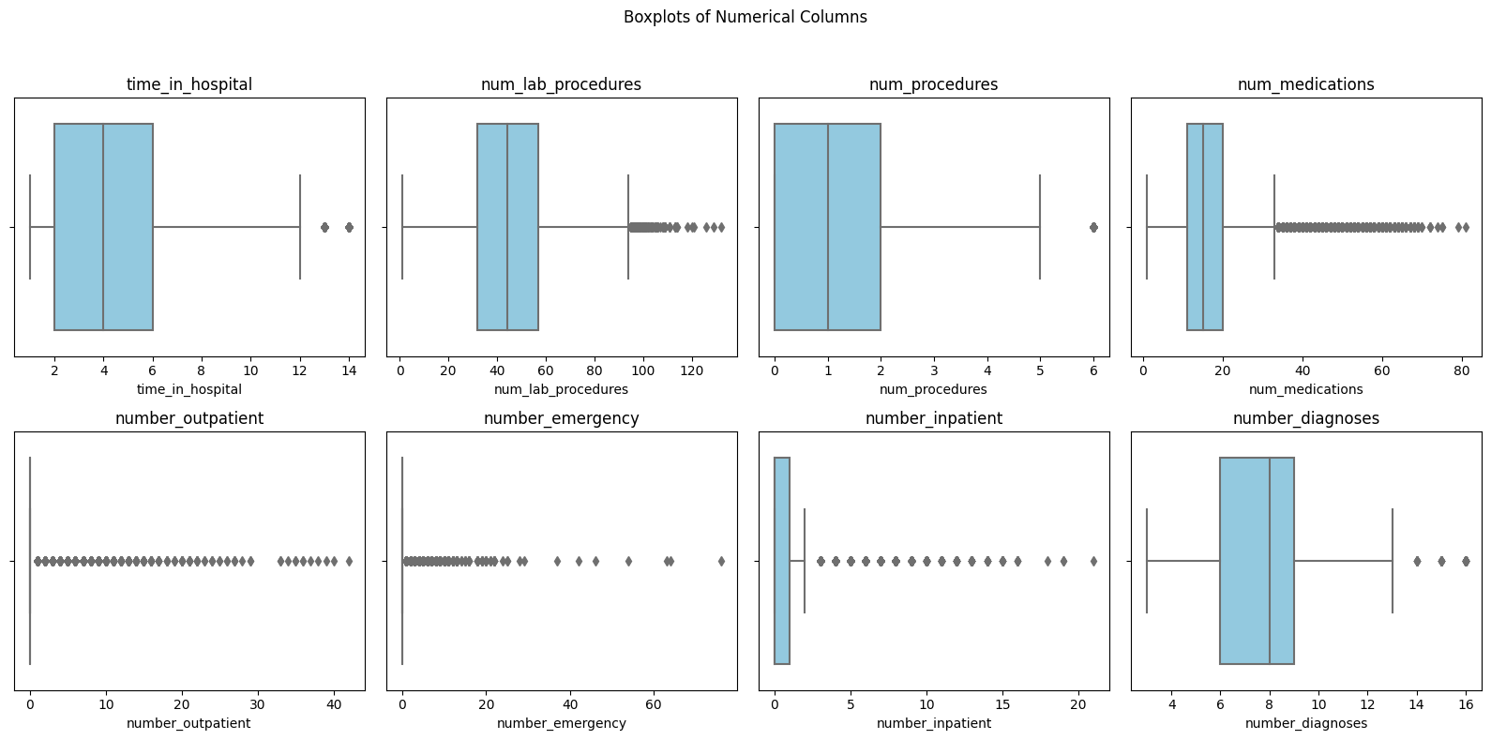
Boxplots of Numerical columns are plotted to understand the quartiles and detect outliers

Slide 7
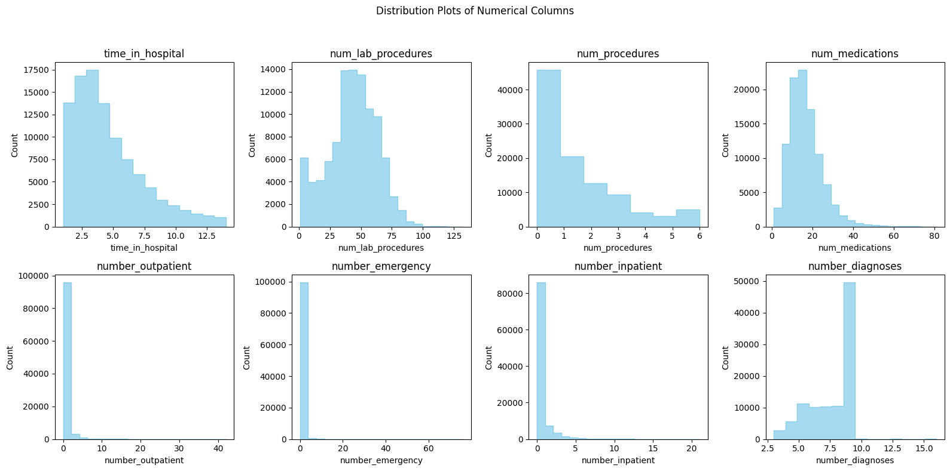
num_lab_procedures, num_medications have a normal/gaussian distribution
num_procedures, number_outpatient, number_emergency, number_inpatient, number_diagnoses appear to have a left skewed distribution
number_diagnoses has a right skewed distribution
However, there seem to be many extreme values and we need to confirm the distribution using other techniques - such as QQ plot

Slide 8
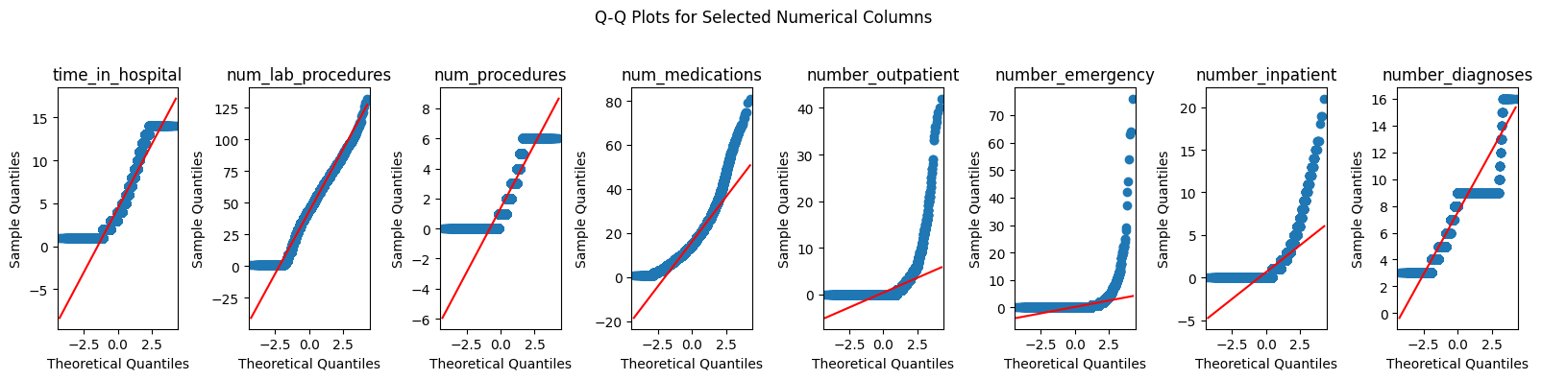
time_in_hospital, num_lab_procedures, num_procedures, number_diagnoses are mostly in line with the theoretical line (ignoring the tails) indicating that it has a gaussian distribution
num_medications, number_outpatient, number_emergency and number_inpatient have many outliers and as a result, don't seem to follow a gaussian distribution.
Hence, we transformed predictors using log, cube root, polynomial transformations so they follow gaussian distribution for it to be applied to models like NB

Slide 9
Feature Selection using Statistical Tests
Student's t-test & Mann-Whitney U test: To understand if numerical variables are associated with the target variable statistically
Chi-squared test & Cramer’s V test: To identify associations between categorical variable pairs given a class and wrt target variable

Slide 10
NAIVE BAYES
Naive Bayes can handle both text and categorical features.
Using EDA and statistical tests, independent features were identified, which were Gaussian given class for numerical. The non-Gaussian features were then transformed to Gaussian.
E.g., Number_inpatient was resolved using cuberoot. The Gaussian NB technique cannot be used with number_outpatient and number_emergency, because they could not be converted to Gaussian.

Slide 11
LOGISTIC REGRESSION
Models of logistic regression presume a decision boundary that is linear between classes. When features and the log-odds of the result have a roughly linear relationship, logistic regression can work effectively.
The significance of each feature can be evaluated in the classification decision using logistic regression.
Direction and strength of each feature's impact can be determined by the magnitude and sign of the coefficients.
'Number_inpatient' was identified to be somewhat linearly separable.
Categorical features that have at least moderate association with target were chosen and dimension reduction techniques (like selecting top N categories within a column) were used.

Slide 12
NEURAL NETWORKS:
Neural networks learn intricate non-linear relationships within the data, which is useful when working with complex patterns that linear models can find difficult to capture.
Both categorical and numerical data can be handled by neural networks, especially when the dataset includes such variables.

Slide 13
MODELS SELECTION(Neural Networks)
Model Evaluation:
Test Accuracy: 0.6307
Precision: 0.6175
Recall: 0.5412
F1-Score: 0.5768
Specificity: 0.7086
Bias and Variance:
Bias Squared: 0.3695
Variance: 0.0859
Noise: 0.3660
Time Taken: 676.45 seconds
Memory Used: 2552.55 MB

Slide 14
CONCLUSION
We see that based on Expected Loss the best model is Neural Networks for the following hyperparameters: {'solver': 'adam', 'learning_rate': 'adaptive', 'hidden_layer_sizes': (50,), 'alpha': 0.001, 'activation': 'logistic'}
On comparing accuracy, sensitivity, precision and f1 score across 3 models, Overall we see that Neural Networks performs the best. Though sensitivity, an important metric for this specific use case is highest for logistic regression, all other measurement metrics perform poorly.

Slide 15
CONCLUSION
In our case, as baseline model we'd predict every value in target variable as 0 (since this is the majority class), In this case we get an accuracy of 53.69%
We see that accuracy of logistic regression (52.16%) is less than the baseline model. Accuracy of Naive Bayes (61.07%) and Neural Networks (63.07%) is better than the baseline model.

Slide 16
THANK YOU!

